Slide 1

Risk Management Analysis on Cryptocurrency Portfolio
Lince Rumainum

Slide 2
Background
Cryptocurrency – “a digital asset designed to work as a medium of exchange using cryptography to secure transactions, to control the creation of additional value units, and to verify the transfer of assets.” (Härdle 3)
Blockchain – “a distributed ledger technology (DLT) that allows data to be stored globally on thousands of servers – while letting anyone on the network see everyone else's entries in near real-time. That makes it difficult for one user to gain control of, or game, the network.” (Mearian)

Slide 3
cryptocurrency

Slide 4
Top 10 cryptocurrencY
Bitcoin (BTC)
Ethereum (ETH)
Ripple (XRP)
Bitcoin Cash (BCH)
Bitcoin SV (BSV)
Tether (USDT)
Litecoin (LTC)
EOS
Binance Coin (BNB)
Monero (XMR)

Slide 5
Type of cryptocurrencY
Transaction Mechanism
Distributed Computation
Utility Token
Security Token
Fungible Token
Non-fungible Token
Stablecoins

Slide 6
analysis

Slide 7

Capital Asset Pricing Model (CAPM)
Is there correlation between cryptocurrency with the stock markets?
Is Bitcoin consider a good benchmark market for cryptocurrency?

Slide 8
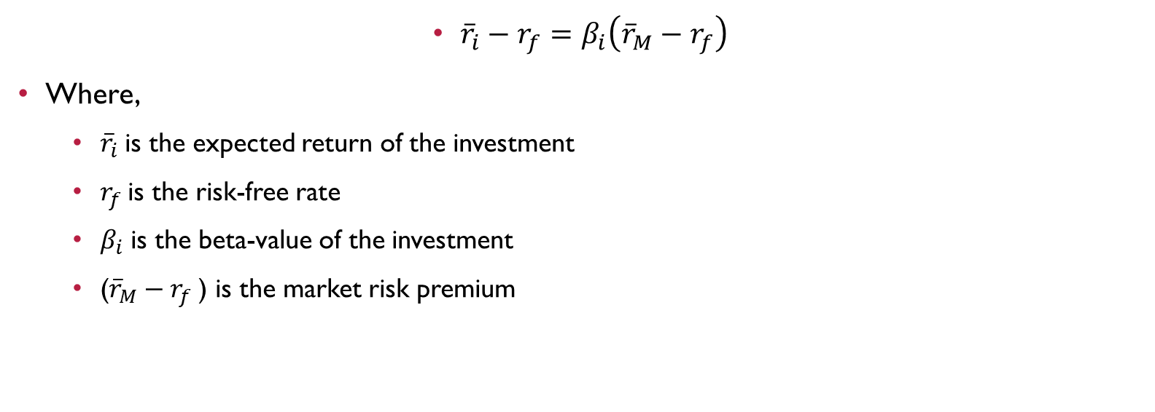
Capital Asset Pricing Model (CAPM)
${\overline{r}}_{i}−r_{f}=β_{i}\left({\overline{r}}_{M}−r_{f}\right)$
Where,
${\overline{r}}_{i}$is the expected return of the investment
$r_{f}$is the risk-free rate
$β_{i}$ is the beta-value of the investment
(${\overline{r}}_{M}−r_{f}$​) is the market risk premium​

Slide 9
data

Slide 10
Is there correlation between cryptocurrency with the stock market?

Slide 11
Is there correlation between cryptocurrency with the stock market?

Slide 12
Is there correlation between cryptocurrency with the stock market?

Slide 13
Is there correlation between cryptocurrency with the stock market?

Slide 14
Is there correlation between cryptocurrency with the stock market?

Slide 15
Is Bitcoin consider a good benchmark market for cryptocurrency?

Slide 16
Is Bitcoin consider a good benchmark market for cryptocurrency?

Slide 17
Is Bitcoin consider a good benchmark market for cryptocurrency?

Slide 18
Is Bitcoin consider a good benchmark market for cryptocurrency?

Slide 19
Is Bitcoin consider a good benchmark market for cryptocurrency?

Slide 20
Is Bitcoin consider a good benchmark market for cryptocurrency?

Slide 21
Conclusion

Slide 22
CONCLUSION
Stock market does not correlate with cryptocurrency, which support the decentralized principal of cryptocurrency.
01
Using Bitcoin as market benchmark for cryptocurrency portfolio is not always a good idea
02
CAPM might work better if the rate return of the cryptocurrency market are based on the type of the cryptocurrency
03

Slide 23
REFerences
Brauneis, A., & Mestel, R. (2019). Cryptocurrency-portfolios in a mean-variance framework. Finance Research Letters, 28, 259-264.
Härdle, W. K., Harvey, C. R., & Reule, R. C. G. (2018). Understanding Cryptocurrencies. International Research Training Group 1792, 1–39. Retrieved from https://papers.ssrn.com/sol3/papers.cfm?abstract_id=3360304
Harvey, C. R. (2014). Cryptofinance. Retrieved from https://papers.ssrn.com/sol3/papers.cfm?abstract_id=2438299
Inci, A., & Lagasse, R. (2019). Cryptocurrencies: Applications and investment opportunities. Journal of Capital Markets Studies, 3(2), 98-112.
Liu, J., & Serletis, A. (2019). Volatility in the Cryptocurrency Market. Open Economies Review, 30(4), 779-811.
Luenberger, D. G. (n.d.). Chapter 7 The Capital Asset Pricing Model. In Investment Science (pp. 173–181).
Mearian, L. (n.d.). What is blockchain? The complete guide. Retrieved from https://www.computerworld.com/article/3191077/what-is-blockchain-the-complete-guide.html
(n.d.). Retrieved from https://finance.yahoo.com/

